Slide 2
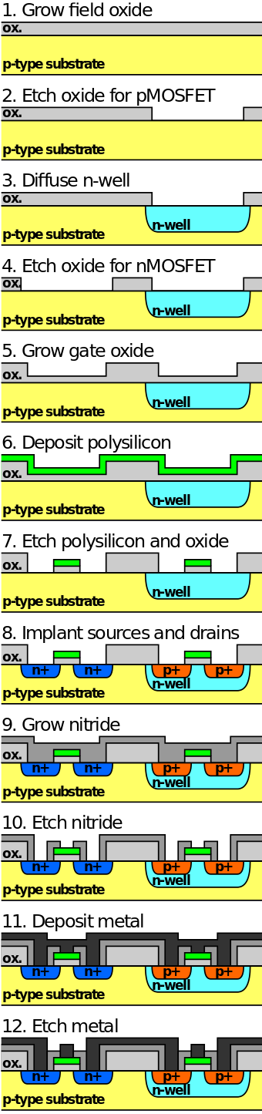
Overall
Grow oxide
Grow polysilicon (the reason use polysiclion instead of metal: smaller threshold voltage than metal. Modern semicon uses smaller Vth) reference link

Slide 3
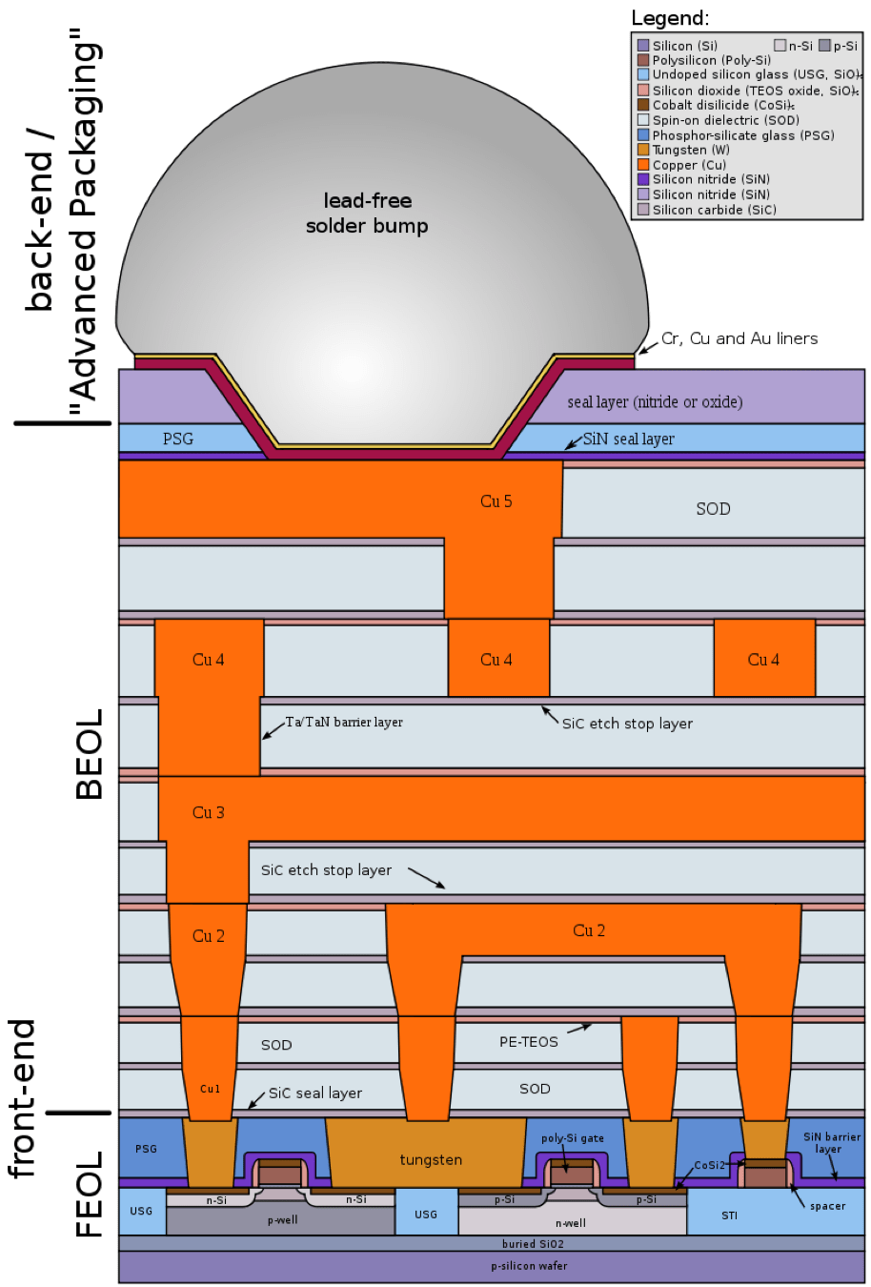
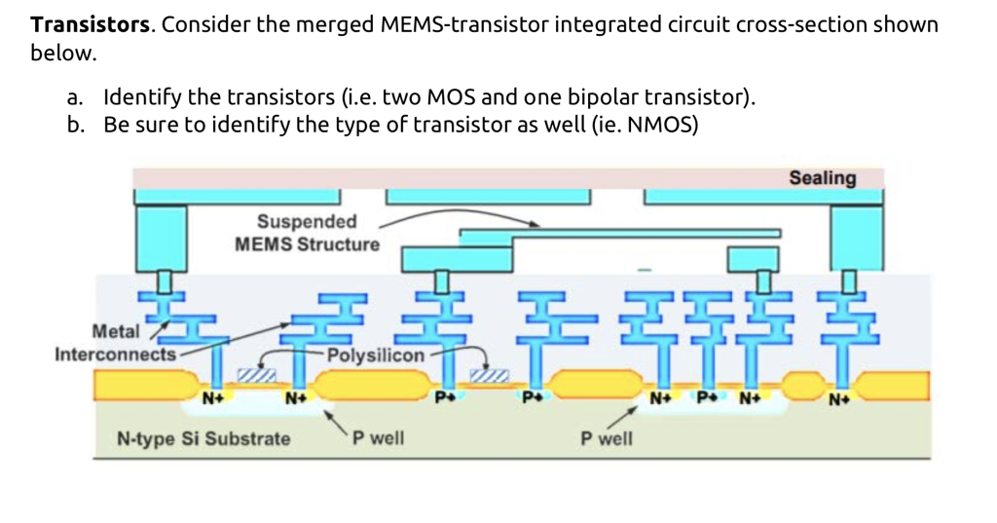
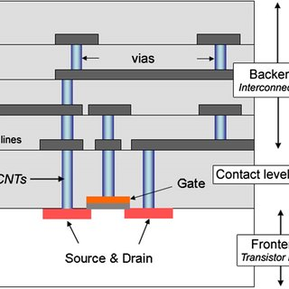
FEOL vs BEOL
FEOL: individual transistor
BEOL: Metal deposition for interconnection

